Slide 1

GREEN HOUSE MONITORING AND CONTROL
1
By team: dynamic developers

Slide 2
ABSTRACT
2
The aim of this paper is to design a greenhouse monitoring system based on the Internet of things (Iot). A greenhouse is a covered area where plants grow and cultivate.
It is also known as land of controlled crops and plants. There are some important parameters to be monitored inside the greenhouse are temperature, humidity, soil moisture, light dependent resistor (ldr), using DHT11, LDR, Soil moisture sensor. It will start monitoring when these sensors are connected.
They are representing the technology solution to automate and improve the management of greenhouse. Internet of things (Iot) was developed for connecting a billion of devices into an internet. A huge amount of information is transferred between the electronic devices.
It is a new way to interact between device and people. This shows that how the wireless communication has been for future vision in the monitoring system. Internet of things (Iot) will play a major role in day to day life in the future.

Slide 3
Problem Statement
3
To use IoT to optimize Greenhouse Environment to grow plants under control of perfect climatic conditions for effective production

Slide 4
Problem Analysis
4
Primarily we need to know the optimized conditions for the plant (here tomato) that are suitable to produce higher and effective yield
Variables such as PH value, temperature
Light levels, humidity ,soil moisture should be monitored for ideal yield.
Later for a large scale these conditions should be applied so, that we can get a higher and effective yield.

Slide 5
Proposed Solution
5
The above variables can be monitored using different micro controllers such as
Arduino Uno
ESP32
Arduino Nano
Or any other board which is having more analog pins.(since the above sensors are analog based)
Conditions are written to tell the micro controller to sense and actuate the sensors as per requirement.
That is what to trigger and what not to trigger according to sensor values.

Slide 6
Proposed Solution-(cont..)
6
To further enhance the usability of this application ,we link the data that is received from the sensors to cloud and automate as per our requirement.
In this case we are using IBM cloud and node red interface for interactable GUI and also for message notifications we link it with MSG91 API
We further introduced machine learning to predict the conditions whether they are normal or extreme for the plant growth using previous ideal data sets.

Slide 7
WORKING PROCESS
7
Initially we read the following parameters using respective sensors which are linked to microcontrollers.
(Arduino Uno & NODEMCU)
Humidity
Temperature
Soil moisture
Light intensity
Now the values related to the above parameters are uploaded to cloud where these values are displayed by means of the Web User interface and API application.
In the UI, control keys are being provided, with these keys the user can switch On and Off motor in accordance with the recorded soil moisture values.
An automatic On & Off control of the motor is also provided for the user convenience.

Slide 8
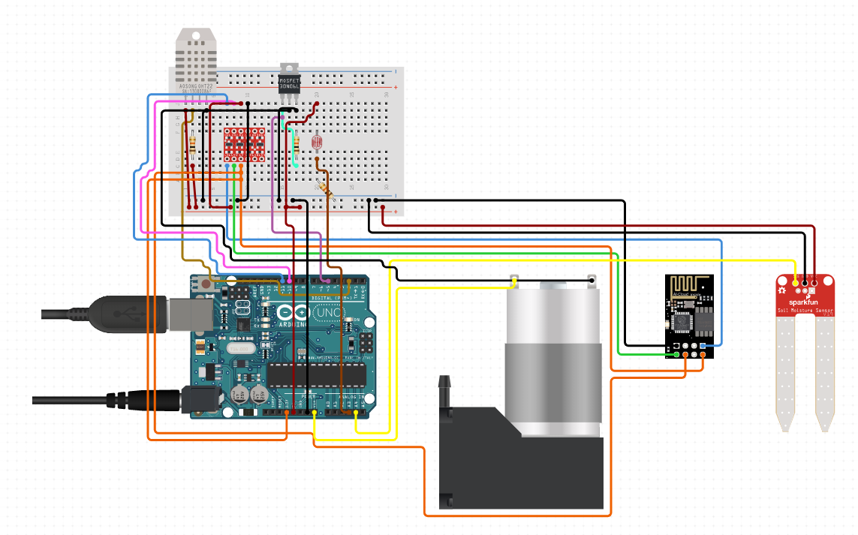
Breadboard Layout
8

Slide 9
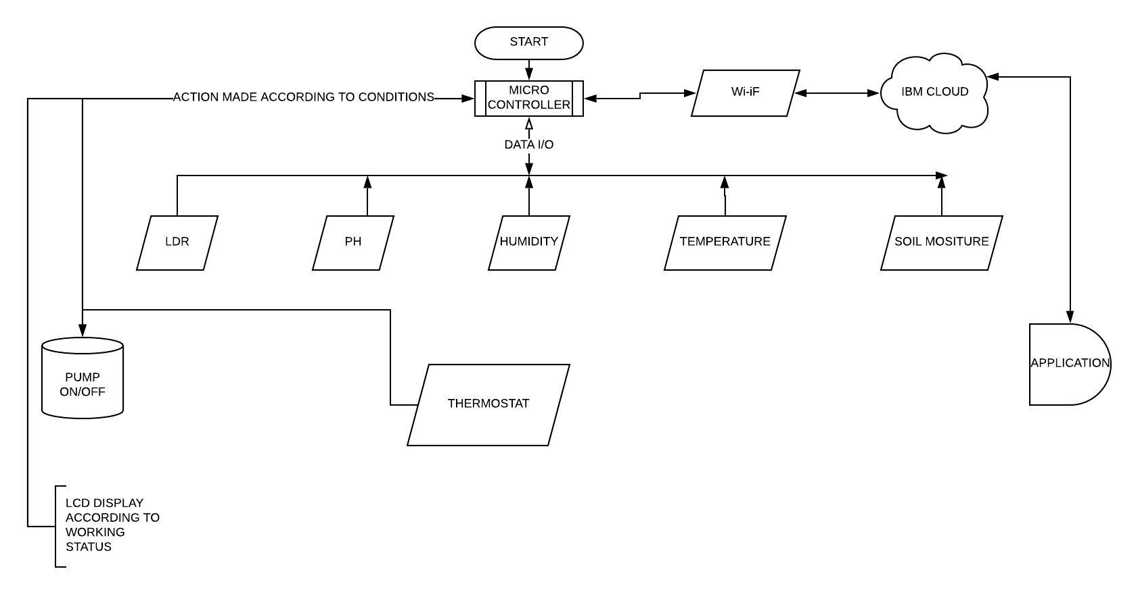
FLOW CHART
9

